Slide 1


Slide 2
What Will Be Covered?
Problem Identification
Target Market
Competitive Analysis
Financial Projections
Financial Strategic Plan

Slide 3
Problem Identification:
Have You Ever Felt Out of Control? Stressed? Overwhelmed?
Problem Identification
Notes:
“3rd year student. I have regularly experienced extreme levels of stress this semester as the absence of a fall break allows major assignments to be due the same days as exams worth 20%+. I have felt suicidal in the past months and have reached out to NAIT counselling center to help me resolve this issue. I feel that a segregated week to write exams is beneficial to the mental and physical health and success of students. As the institution I choose to attend and pay for, I expect NAIT to look out for the best interest of it's students (customers, future employees and employers of Alberta and Canada). This is not the best interest.”
“Assignments after assignments . . . I never remember to do them on time . . . I need a break, or at least a week to get through and catch up at least because we're approaching the end of the semester and things are starting to get really busy.” ~ NAIT Survey Respondent

Slide 4
90%
63%
50%
Feel Overwhelmed
(Globe and Mail, 2017)
Feel Alone
(Globe and Mail, 2017)
Feel Hopeless
(Globe and Mail, 2017)
Problem Identification
Notes:
Almost 90 per cent of students said that they felt overwhelmed by all they had to do in the past year, while more than 50 per cent said they felt hopeless and 63 per cent said they felt very lonely.
can conduct business operations with no restrictions

Slide 5
Solution
Ongoing Support
Skill Development
Empowerment
Solution

Slide 6

Who We Are
Who We Are

Slide 7
MILLENNIALS
IN POST-SECONDARY ● AGED 20 – 24 ● SEEKING SUPPORT
Target Market

Slide 8
Competitive Analysis
Trends
Competition
Opportunities
Competitive Advantage
Competitive Analysis
Notes:
Competition
Opportunities
Competitive Advantage

Slide 9
Financial Projections
 | Projected Revenue | Projected Gross Profit | Projected Net Profit After Tax
Year 1 | $29.860.00 | $28,367.00 | $640.00
Year 2 | +269.63% | +259.55% | -23.87%
Year 3 | +62.25% | +25.10% | +135.00%
Financial Projections
Notes:
Projected Revenue
Year 1 – 29,860
Year 2 – 110,371
Year 3– 179,076
Projected Gross Profit
Year 1 – 28,367
Year 2 – 101,993
Year 3 – 127,592
Net Profit After Tax
Year 1 – 640
Year 2 – (-14,637)
Year 3 – 5,124
Increase = New Number - Original Number
% increase = Increase ÷ Original Number × 100.

Slide 10
Financial Strategic Plan
$25,000 Currently Invested
2 Stage Financial Plan
Financial Strategic Plan

Slide 11
Financial Strategic Plan
Phase 1: Short-Term Objective
Seek A $15,000 Loan from Futurpreneur
Why: Operational Costs & Asset Acquisition
Phase 2: Long-Term Objective
Acquire a $50,0000 Loan from BDC
Why: Expand Operations, Purchase Assets & Increase Marketing
Financial Strategic Plan

Slide 12
Financial Strategic Plan
Phase 1: Short-Term Objective
Seek A $15,000 Loan from Futurpreneur
Why: Operational Costs & Asset Acquisition
Financial Strategic Plan

Slide 13
Questions?

Slide 14
References
The Globe and Mail. (2017). Canadian Students Feel Stress, Anxiety, Have Suicidal Thoughts, Survey Reveals. Retrieved From https://www.theglobeandmail.com/news/national/education/college-university-students-feel-stress-anxiety-have-suicidal-thoughts-survey-reveals/article12613742/

Slide 15
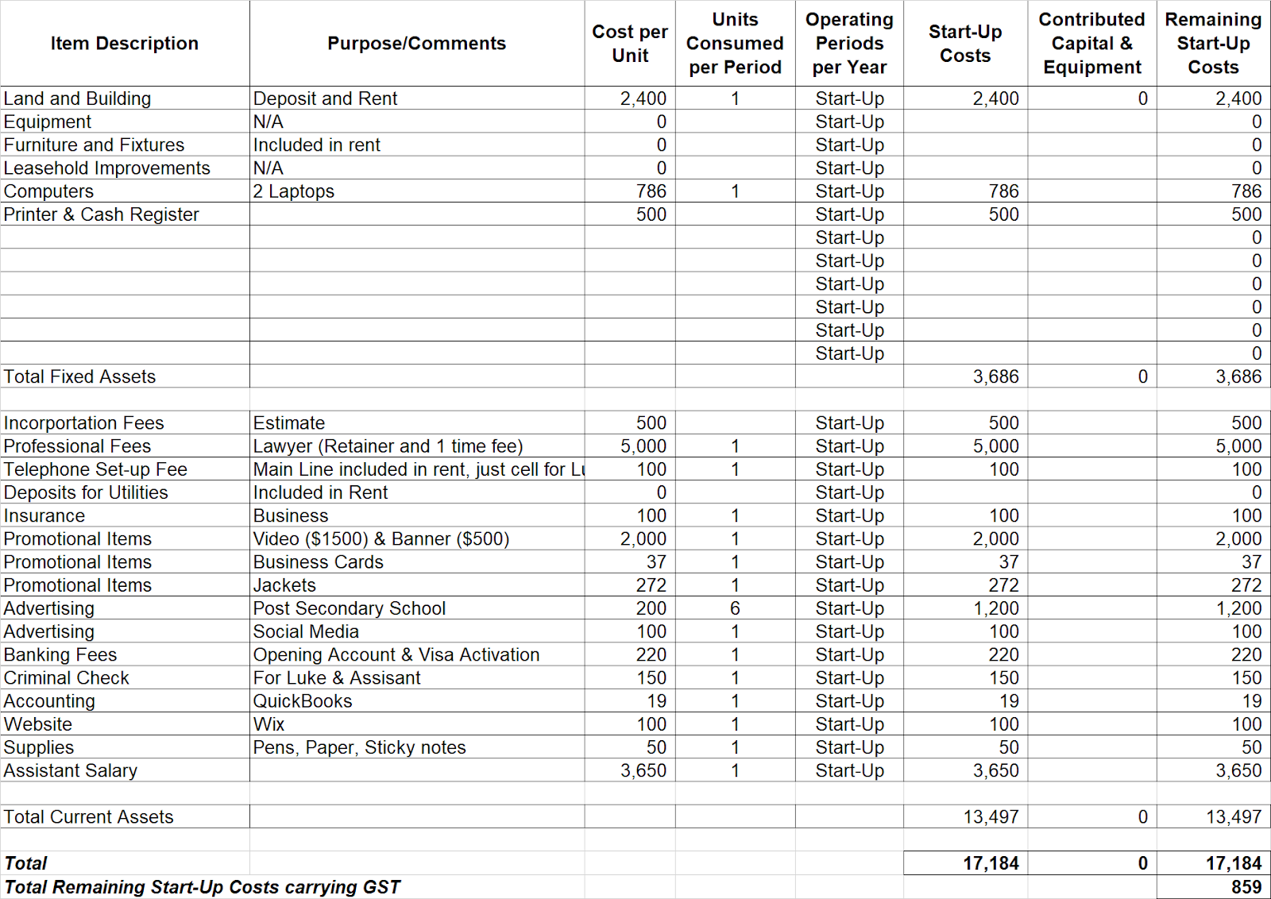
Appendix A Start-Up Costs

Slide 16
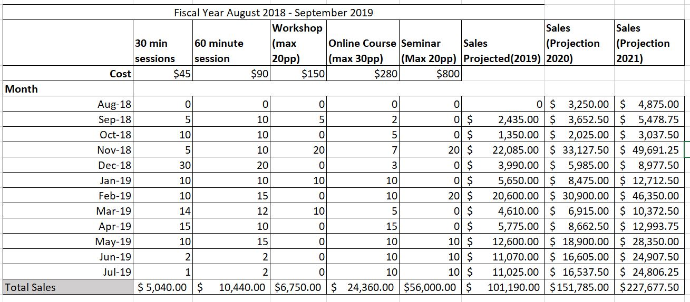
Appendix B: First Year Projected Sales

Slide 17
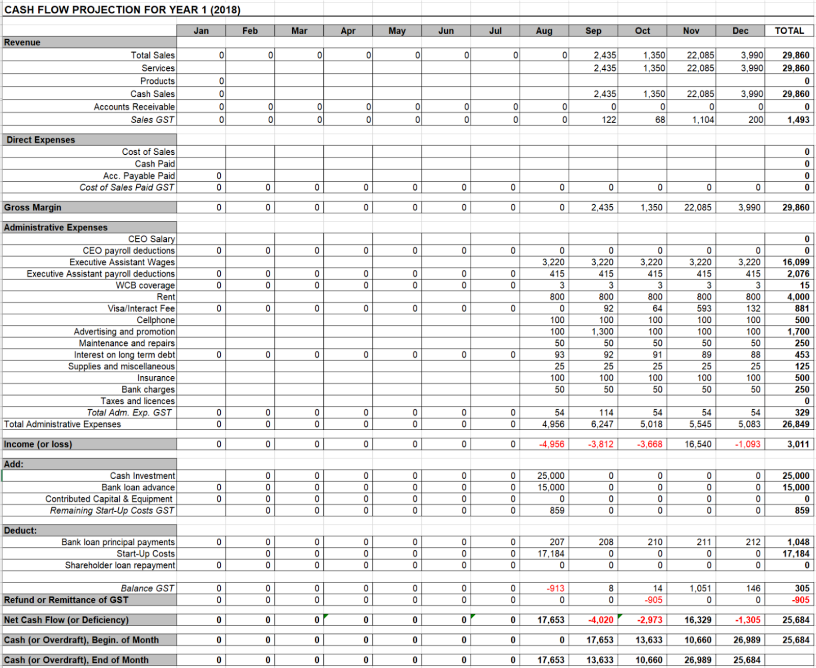
Appendix C: Cash Flows

Slide 18
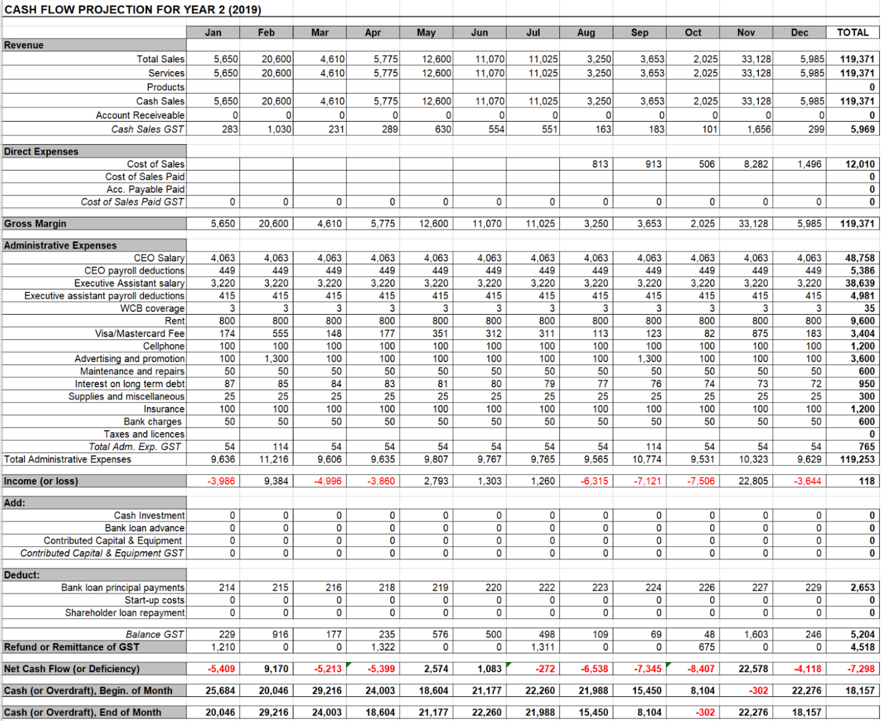

Slide 19
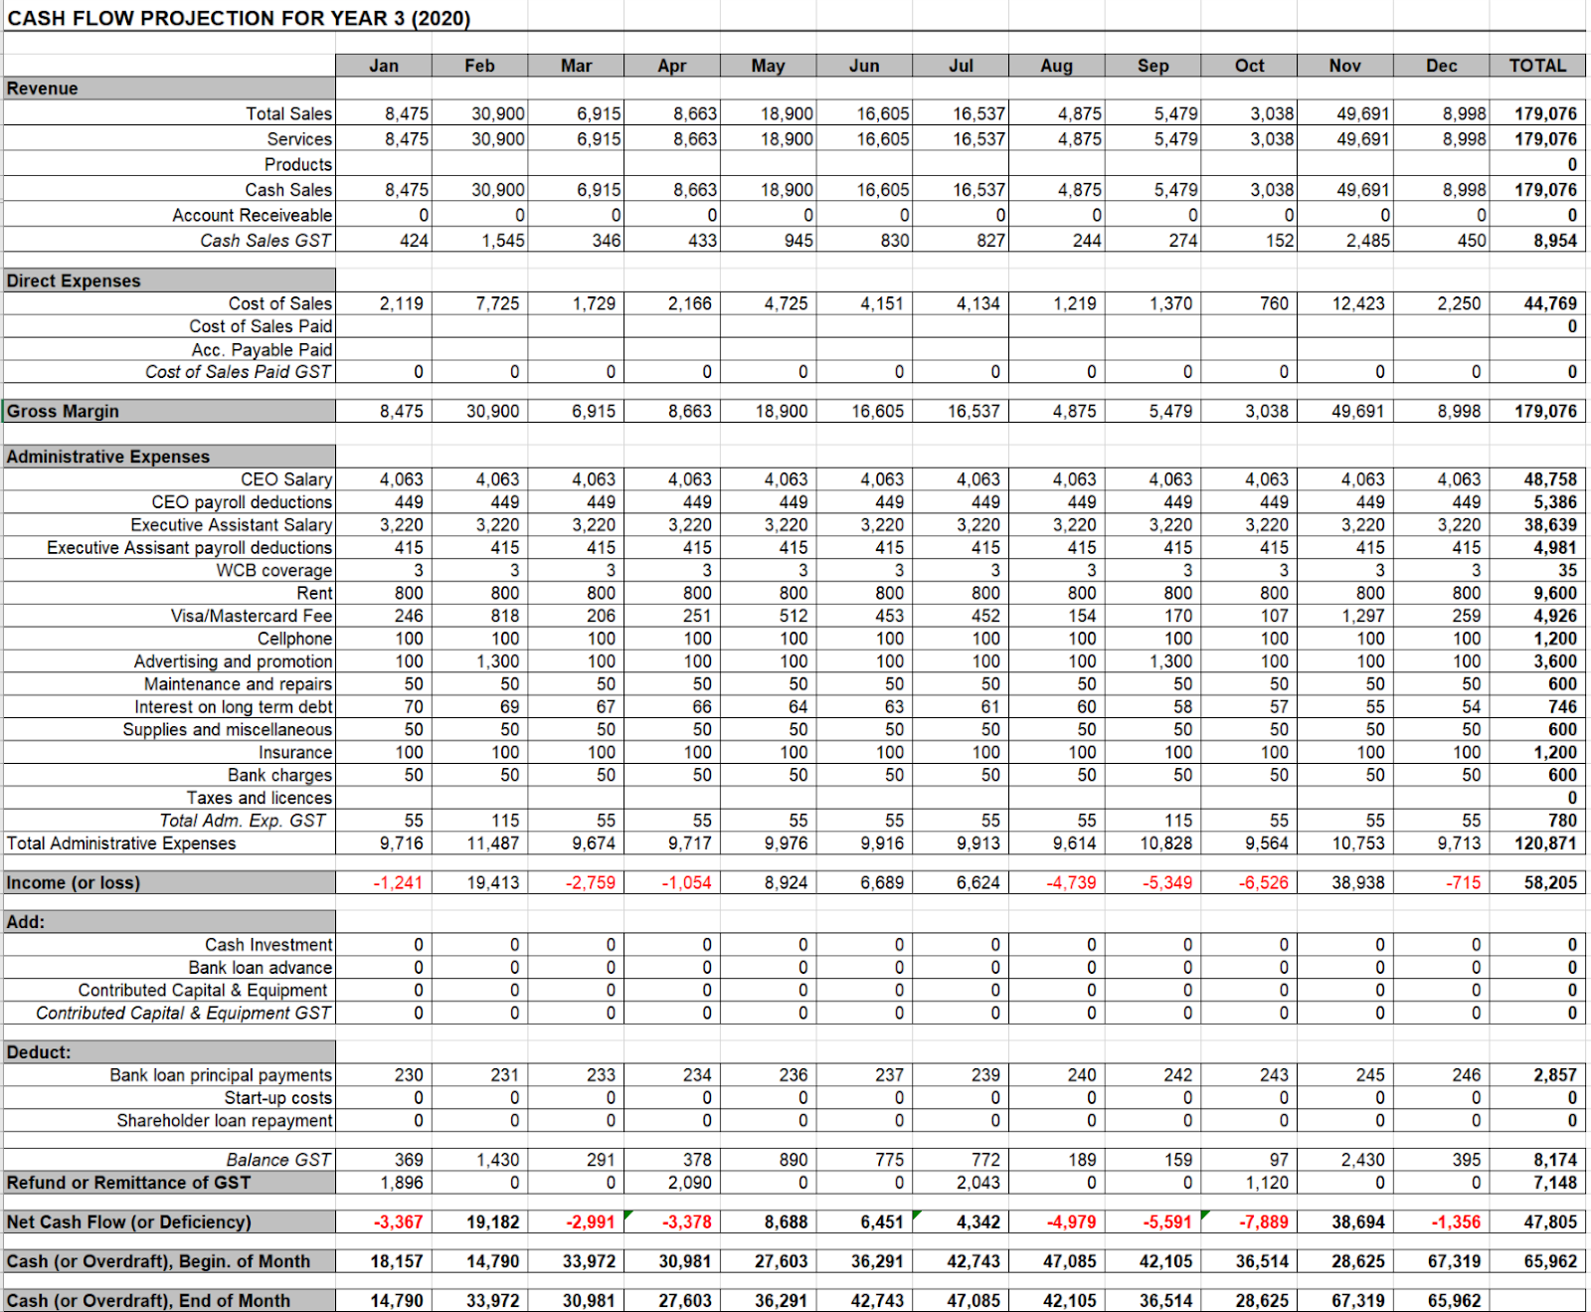

Slide 20
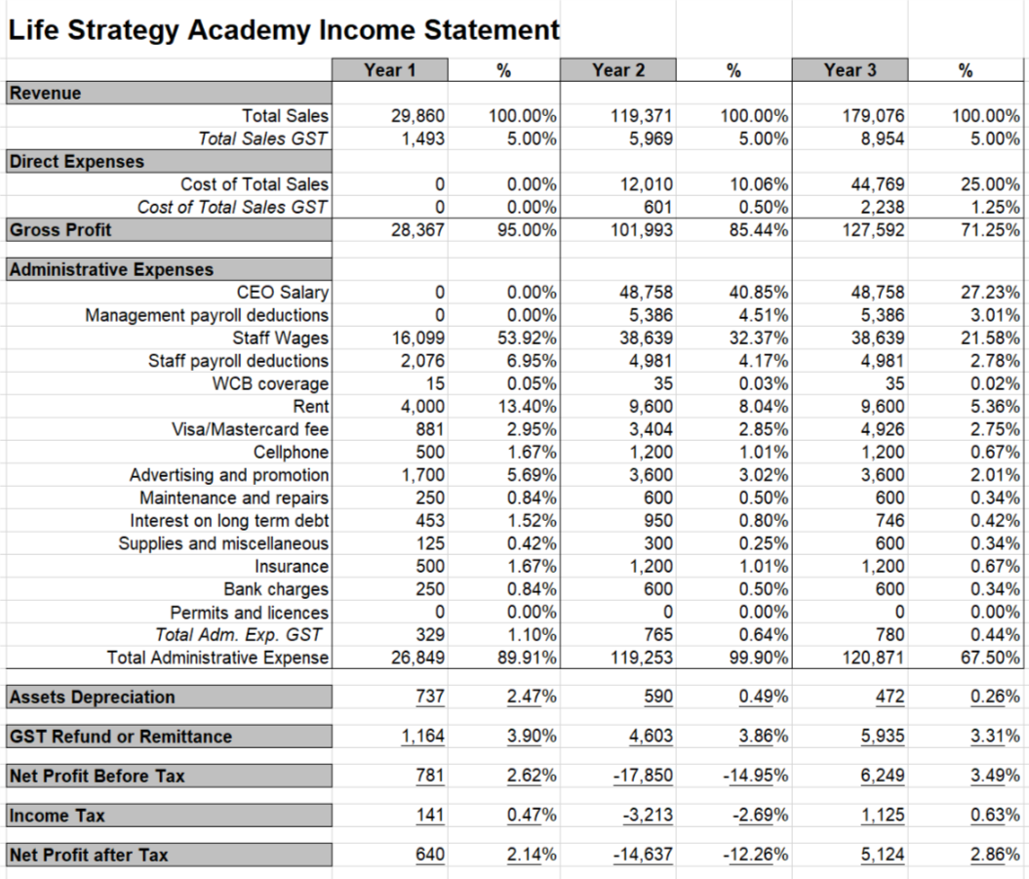
Appendix D: Income Statement

Slide 21
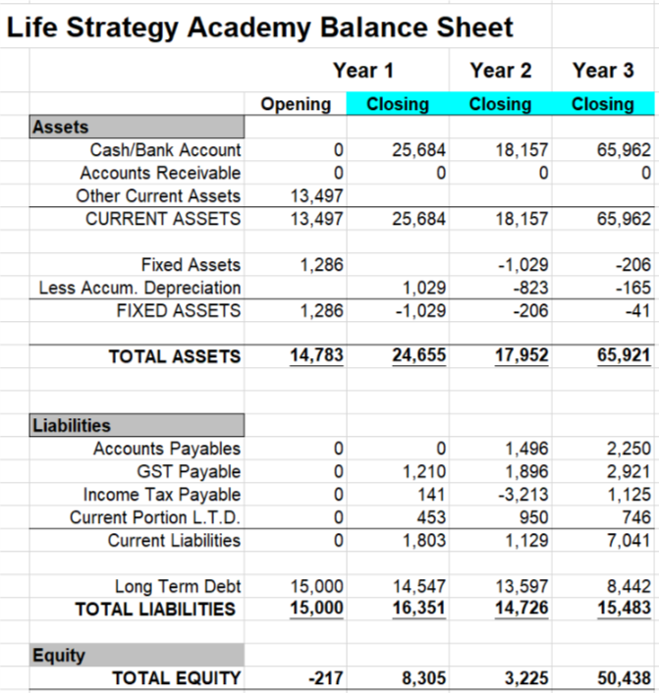
Appendix E: Balance Sheet

Slide 22
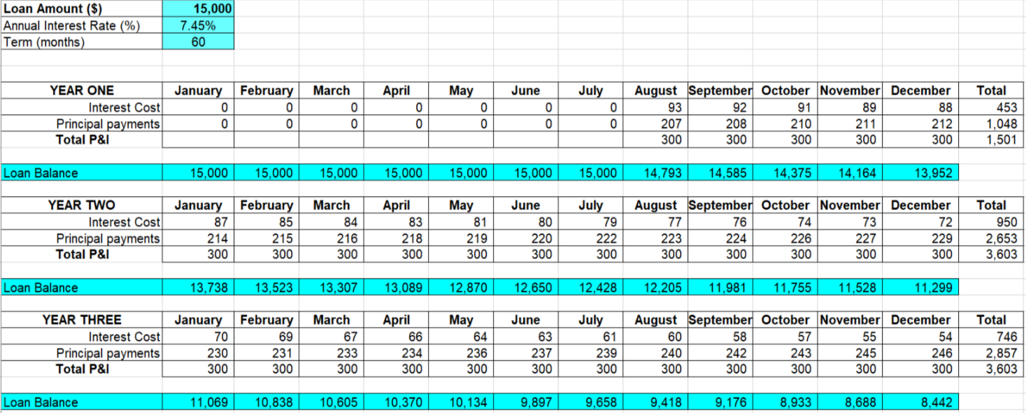
Appendix F: Bank Loan Calculation

Slide 23
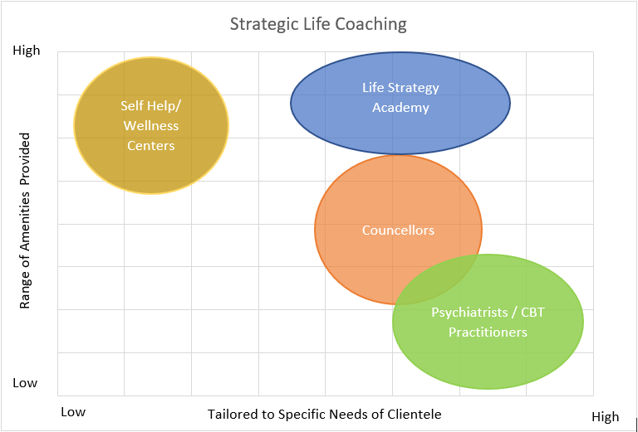
Appendix G: Market Position

Slide 24
Appendix H: Pricing Options
Standard Fees
Bundling Packages
Initial consultation (one time fee) - $20.00
6 Hour Online Course (with access to coaches via online chats, emails and call center) - $280.00
One-on-one session
30 Min - $45.00
60 Min - $90.00
3 Hour Workshop - $150
16 Hour Seminar - $800
Initial consultation and one . . .
30 Min one-on-one session - $40.00
60 Min one-on-one session - $70.00
Initial consultation and 3 hour workshop - $155.00
Initial consultation, 6 hour online course and 2 . . .
30 Min one-on-one session - $350.00
60 Min one-on-one session - $400.00
5 Session Packages
30 Min - $125.00
60 Min - $275.00

Slide 25
Appendix I Risk Assesment
Risk Assessment of Various Factors
 | Low | Medium | High
Service Liability |  |  | X
Seasonality of Business |  | X
Substitutions |  | X
Customers |  | X
Suppliers and Personnel |  | X
Cost Structure and Profit Margin | X
Complementary Industries | X
Management | X

